Slide 1
Neuro technology
Unlocking the brain to the technology
PRESENTED BY
DEEPAK A
1ST YEAR
ECE
A Brief explain of the product neuralink

Slide 2
CONTENT
1.NEURALINK
2.HOW IT WORKS
3.ADVANTAGE
4.WHY IT IS BEST
5.HOW IT IS PLACED

Slide 3
NEURA LINK
01
BRAIN MACHINE COMMUNICTION

Slide 4
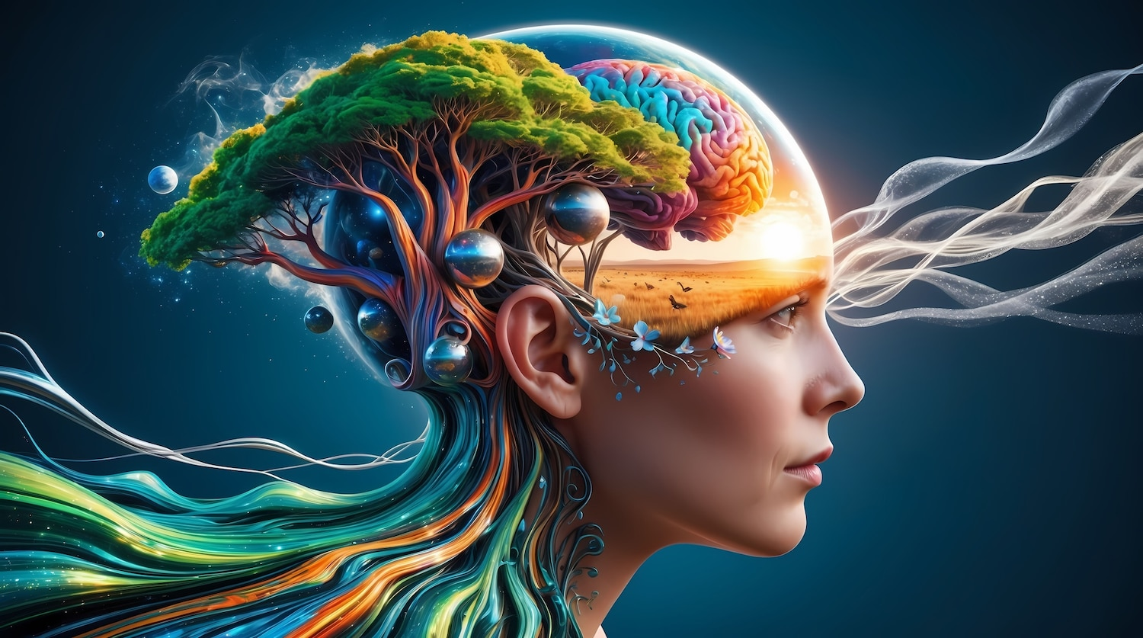
WHAT IS NEURALINK?
A chip has inserted to the brain it interacts with brain and the machine

Slide 5
“The brain has no knowledge until connections are made between neurons. All that we know, all that we are, comes from the way our neurons are connected”
-Google Ai

Slide 6
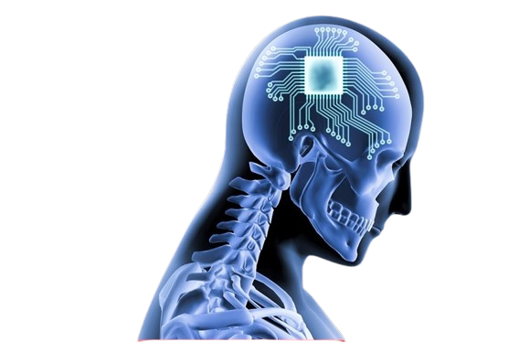
HOW IT WORKS?
Neuralink is a brain-computer interface (BCI) that uses a coin-sized chip implanted in the brain to monitor neural activity and translate it into commands for external devices.

Slide 7
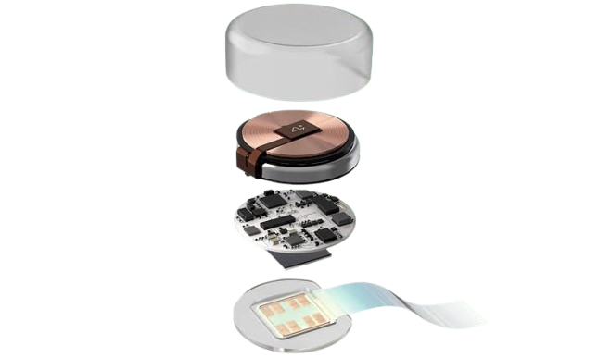
DIAGRAMMATIC REPRESENTATION OF NEURO CHIPS AND THEIR FUNCTIONS
1.BATTERY-It stores the energy for the neural activity and the device
2.MICRO CHIPS-The microchip in Neuralink's brain-computer interface (BCI) monitors and stimulates brain activity using electrical currents
3.ELECTRODE THREADS-It is 64 ultra-thin, flexible threads to carry 1,024 electrodes that record neural activity

Slide 8
ADVANTAGES
1.Improved quality of life: Neuralink could improve the quality of life for people with disabilities, such as those who are paralyzed, blind, or deaf.
2.Enhanced cognitive abilities: Neuralink could enhance human cognition, creativity, problem-solving, and learning.
3.Better connectivity: Neuralink could improve connectivity between humans and devices, allowing people to control machines with their thoughts.

Slide 9
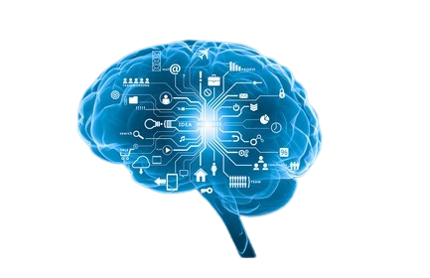
WHY IT IS BEST
1.Improve Communication for Non-verbal Individuals
2.Neuralink's brain chips will replace phones in the future.

Slide 10
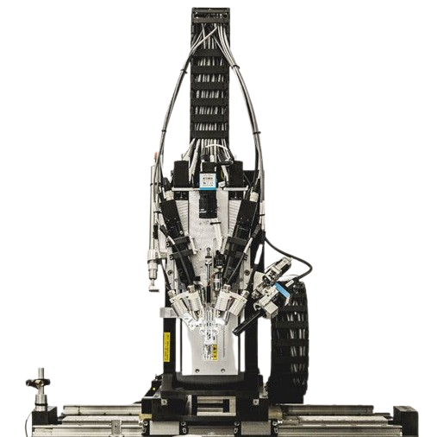
HOW IT IS PLACED
This surgical robot has an insertion head with a 25 μm diameter needle made of tungsten-rhenium designed to attach to the insertion loops, inject individual probes, and penetrate the meninges and cerebral tissue; it is capable of inserting up to six wires (192 electrodes) per minute.

Slide 11
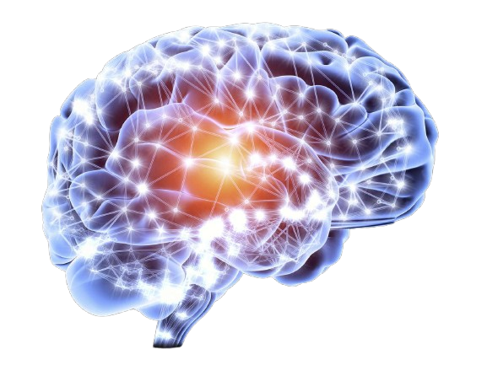
CONCLUSION
1.Neuralink is working on extraordinary technology that could change people's lives.
2.However, some former employees and experts are worried about ethics and safety.
3.It is important to be careful of new ways of connecting human brains with AI.

Slide 12
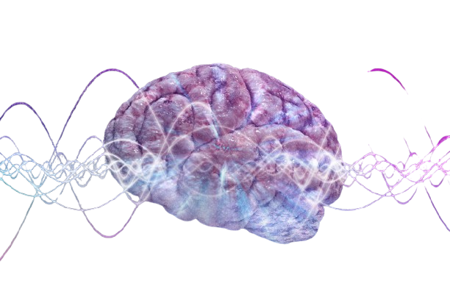
Thank You!!!!

